Slide 1

MGMT 590 - TEAM CRYPTOCAST | UNLEASHING NEXT GEN TRADING
AKANKSHA SINGH & HARSHRAJ JADEJA

Slide 2

Introduction

Slide 3
1
Introduction
Is investing in crypto everyone’s game?
75% of bitcoin investors have lost money(CNBC)
70% of DIY investors lose money (Financial times)
Research: Success is limited until DIY investors break bad habits
90% of investors have lost money in stocks (Everything equity)
38% sold their crypto for less than it was worth when they bought it (lending tree)

Slide 4



1
Introduction
What can investors do to potentially make money on their investments?
Investors face significant challenges in accurately predicting returns and optimizing portfolios for maximum profitability
Problem
Absence of robust techniques tailored specifically to the dynamic nature of the cryptocurrency market
Gap
Solution
Develop AI-driven solutions that offer precise predictions and optimized trading strategies, empowering investors to make informed decisions

Slide 5






1
Solution approach
The road to making more money!
Portfolio Optimization
Create a buy/sell logic to optimize portfolio and maximize results
Future Scope & Learning
Future scope to improve the approach
Data Modification
Handling data anomalies and feature engineering to prepare dataset
Recommendations
Provide recommendations based on model results and portfolio values
Exploratory Data Analysis (EDA)
Dataset description and
identification of trends & patterns in raw data
Predictive Modelling
Predict closing price for each asset at a date level

Slide 6
Data Analysis

Slide 7

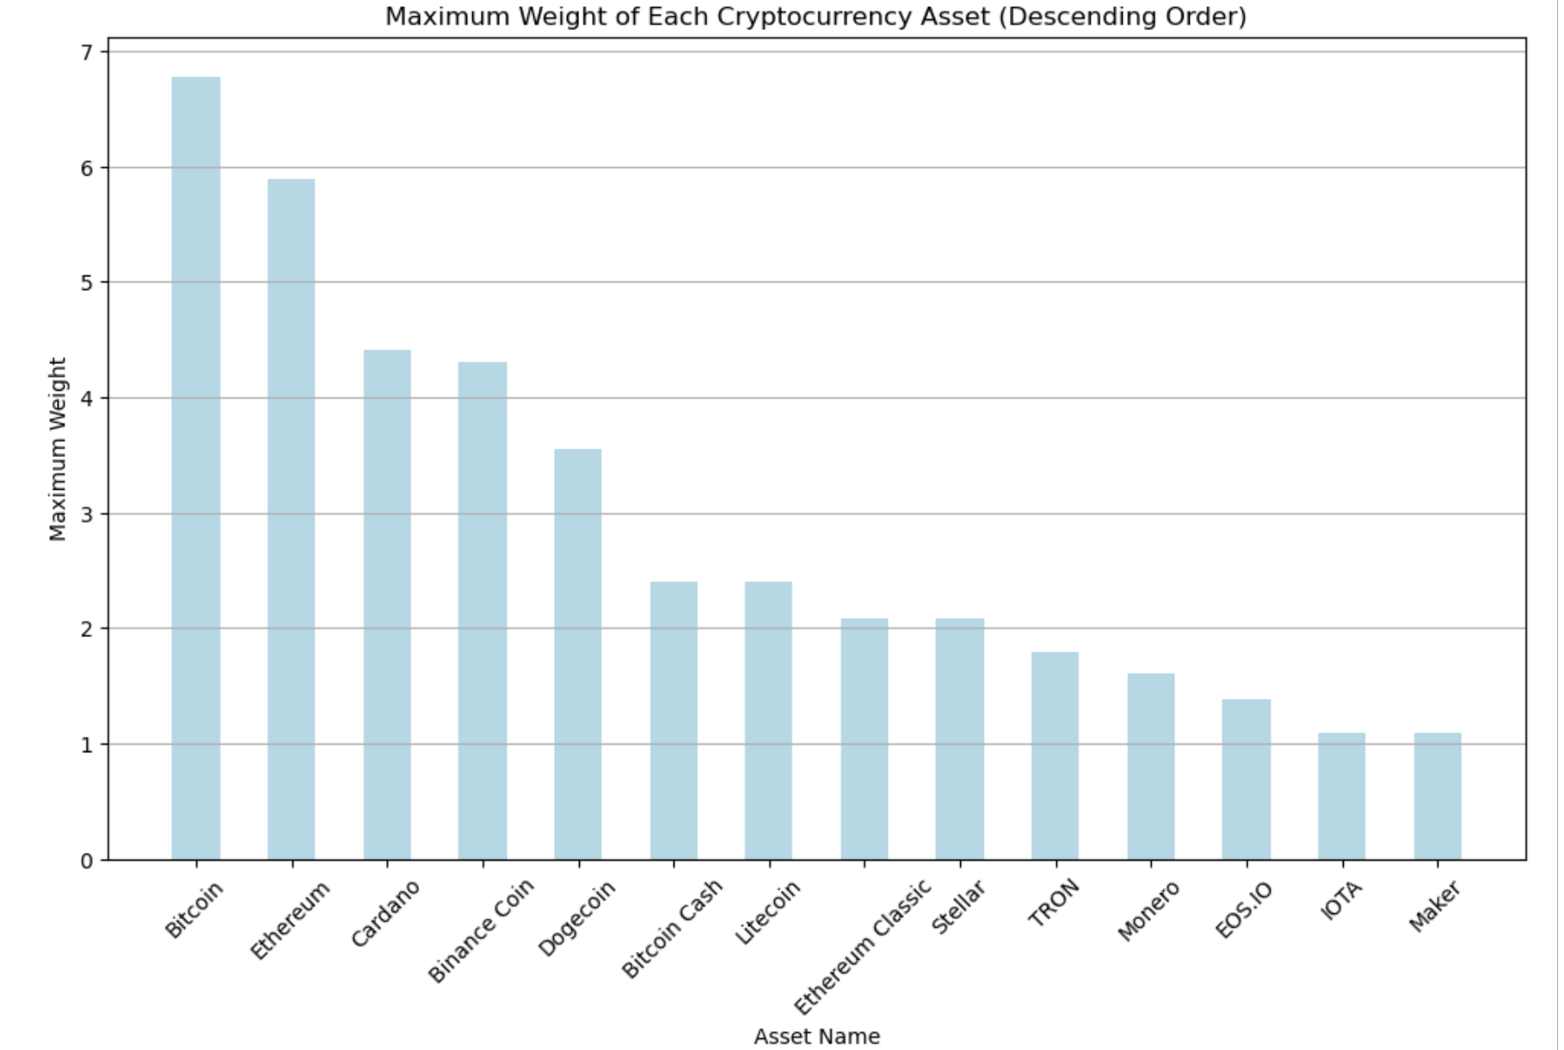




1
EXPLORATORY DATA ANALYSIS
Let’s look at the information we have to predict (guess) the returns!
No. of Rows & Columns
24M Rows & 10 Columns
Level of data
Asset ID, Minute
Unique Assets
14 Unique assets
Training Period
2018-01-01 to 2020-12-31
Testing Period
2021-01-01 to 2021-09-21

Slide 8
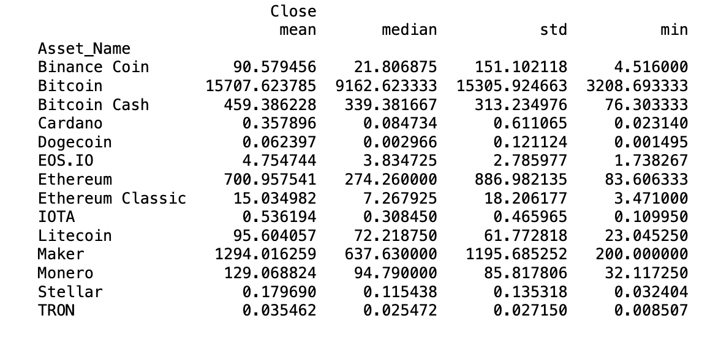
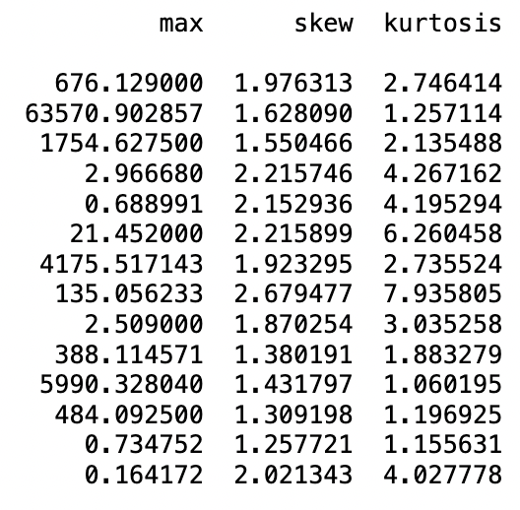
1
EXPLORATORY DATA ANALYSIS
Validating Elon Musk’s dominance over others
Descriptive Statistics
Bitcoin is the most volatile asset, with a high standard deviation in closing prices, suggesting greater risk compared to others like Cardano
The range between the minimum and maximum closing prices is exceptionally wide for Bitcoin, highlighting its dramatic price changes over time, compared to other assets such as TRON

Slide 9
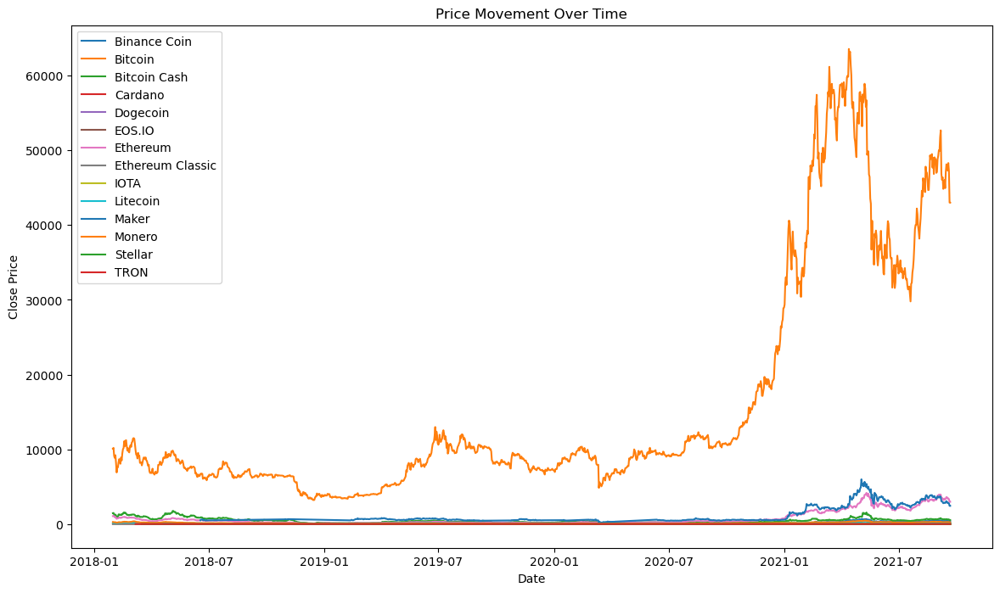
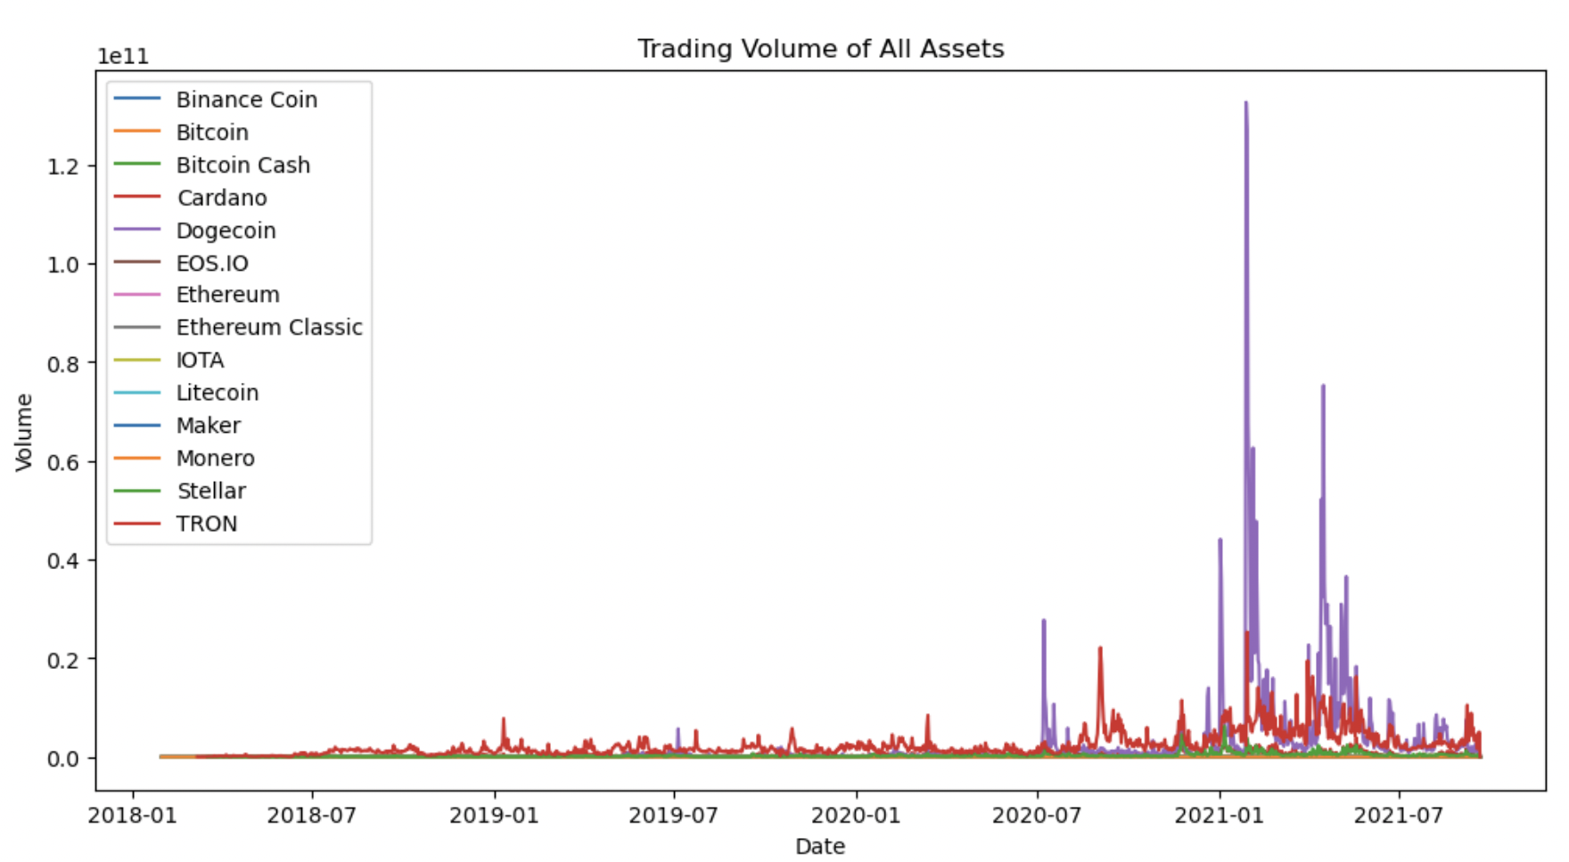
1
EXPLORATORY DATA ANALYSIS
The dominance continues
Price movement over time
Volume movement over time
The first graph indicates that Bitcoin has experienced significantly higher price movements over time compared to other assets, dominating the price scale with its peaks and troughs
The second graph shows sporadic spikes in trading volume, suggesting periods of heightened market activity or events that prompted substantial trading within a short time frame

Slide 10
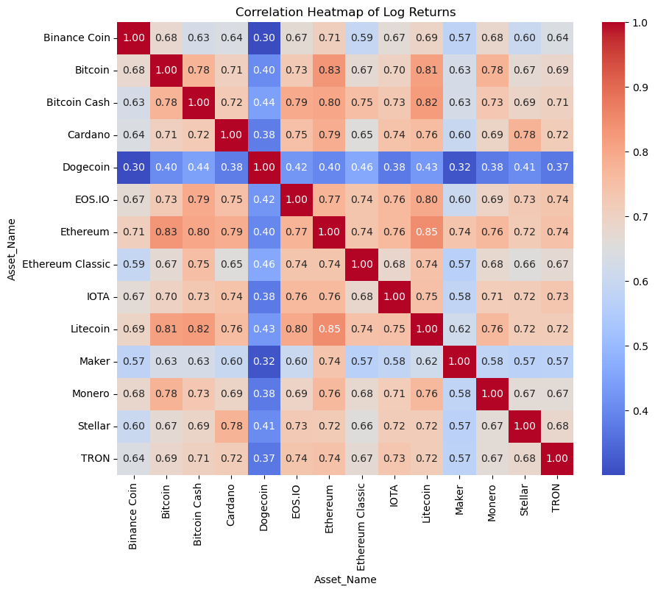
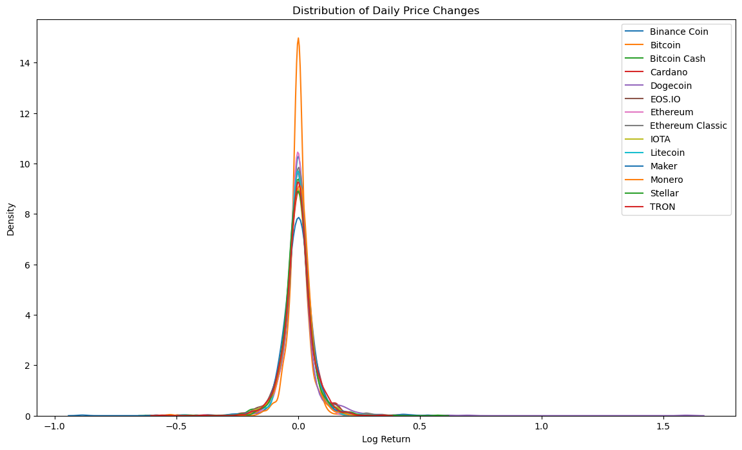
1
EXPLORATORY DATA ANALYSIS
Would investing in multiple related cryptos increase your chances?
Correlation matrix of log returns
Distribution of daily price changes
The correlation matrix shows that most cryptocurrencies have positive correlations with each other, indicating that their log returns tend to move in the same direction, with Bitcoin and Ethereum exhibiting particularly strong correlation
The graph suggests that the log returns are highly peaked around the mean with fatter tails, which implies a higher likelihood of extreme values compared to a normal distribution

Slide 11
Data Preprocessing

Slide 12


Data Preprocessing | Feature Engineering
Move from minutes to days: patience is the key to success!
Layer 1 | Daily Level Data-Frame Creation
Kaggle Dataset
Daily Level Dataset
Open Price
High Price
Low Price
Close Price
Volume Traded
Volume Weighted Average Price (VWAP)
Level: Timestamp (Minute), Asset ID
Day Open Price (First)
Day High Price (Max)
Day Low Price (Min)
Day Close Price (Last)
Daily Sum of Volume Traded (Sum)
VWAP (Last)
Level: Date, Asset ID
All the features have been scaled using Standard Scaler separately for test and train dataset

Slide 13
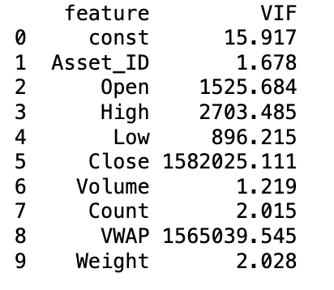
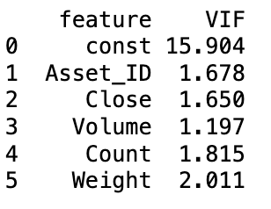
Data Preprocessing | Feature Engineering
Remove that multicollinearity!
Layer 2 | Dropping columns with high VIF
Before
After

Slide 14

Data Preprocessing | Feature Engineering
Gotta add more information to make the prediction right!
Layer 3 | Additional Features Creation
Daily Level Dataset
Additional Variables
Daily Volume (number of crypto asset units traded)
Daily Count of trades
Weight for each Crypto
Returns = Today’s closing price/Yesterday’s closing price
Lagged Features for ‘Close Price’ and ‘Volume’ for the previous day
Simple moving average for ‘Close Price’ for the last 10 and 50 days
RSI indicator is calculated using a formula that normalizes the ratio of upward and downward price movements into a range between 0 and 100
RSI=100−(100/(1+RS)
Where RS = Average Gain / Average Loss
RSI Value Over 70: Typically considered overbought
RSI Value Under 30: Generally viewed as oversold
RSI Value Around 50: Often considered neutral, with no strong momentum
Target variable: Daily Close Price

Slide 15
Predictive Modelling

Slide 16
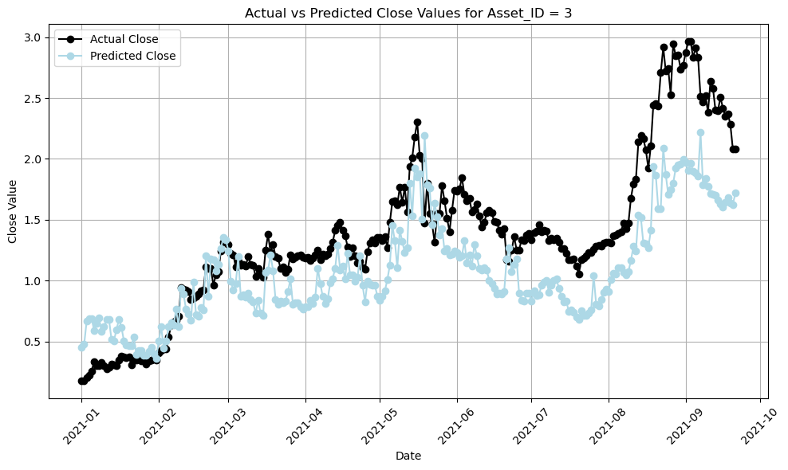
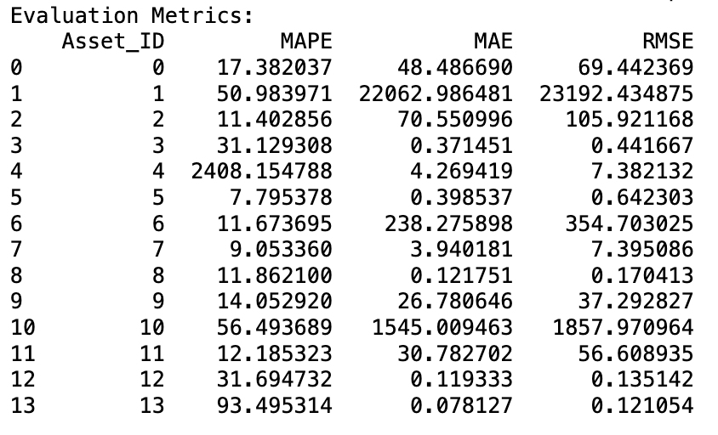

Data modelling | Sequential neural network
Let’s start with the basics!
Sequential Neural Network: It's adept at handling the volatility and complexity of crypto markets
Activation: ReLU for hidden layers to introduce non-linearity
Optimizer: Adam for efficient learning
Loss Function: Mean Squared Error (MSE) for accurate error measurement
Epochs: 50, to balance learning and overfitting
Batch Size: 32, for efficient training

Slide 17
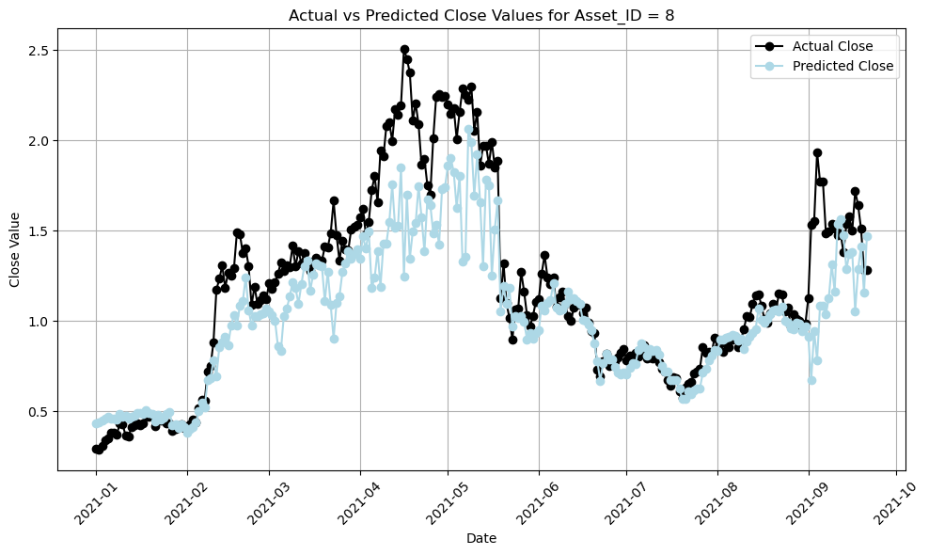
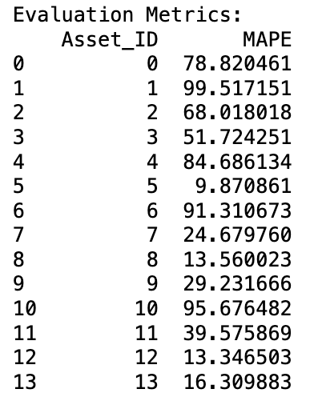
Data modelling | Bidirectional LSTM
Look into the past and future to improve your present!
Bidirectional LSTM: Captures dependencies in both forward and backward directions of the time series
Units: 64 LSTM units in each layer, providing the capacity to learn complex patterns
Dropout: 0.2, to prevent overfitting by randomly ignoring selected neurons during training
Optimizer: Adam, for efficient gradient descent
Loss Function: Mean Squared Error (MSE), focusing on penalizing larger prediction errors
Effective in learning from sequences, making them perfect for the time-series data in cryptocurrency markets

Slide 18
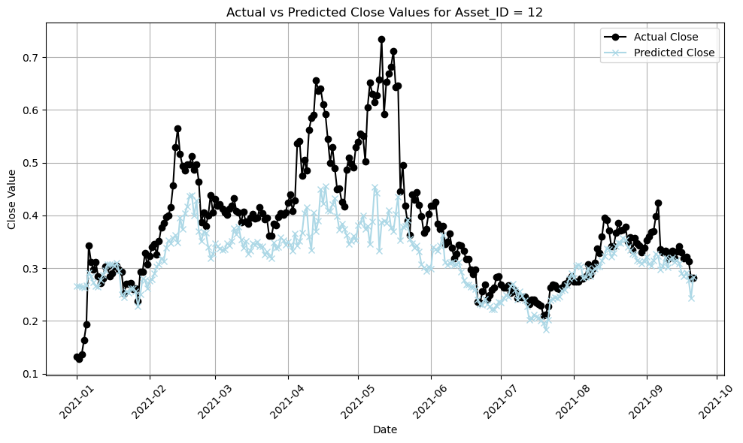
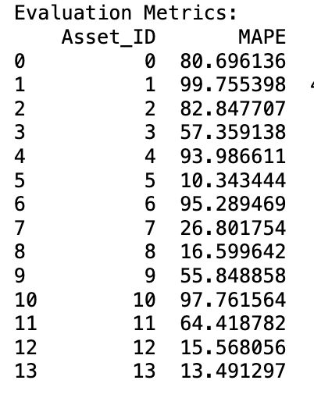
Data modelling | Stacked LSTM
Cos stacked is always better..just like pancakes!
Stacked LSTM: Designed to predict cryptocurrency prices by learning from sequences of data
Layers: Sequential model with three LSTM layers, each with 64 units, followed by Dropout layers set at 0.2 to reduce overfitting by ignoring randomly selected neurons during training
Output: A Dense layer with a single neuron to predict the closing price
Optimizer: Adam, chosen for its effectiveness in handling sparse gradients and adaptive learning rates
Loss Function: Mean Squared Error (MSE), targeting the minimization of prediction errors

Slide 19
Portfolio Optimization

Slide 20







Portfolio Optimization
The secret sauce to success!
Trading Day 1
Trading Strategies Employed
Initial Wallet Balance:
$ 100,000
Assets to Purchase
Stop-Loss
Top 5 Assets (based on predicted percentage returns)
Predicted Percentage Returns > 0
Sell assets when they reach 80% of purchase price
Dynamic stop-loss threshold (80% of purchase price)
Amount Invested
Take-Profit
Amount Invested Per Asset =
Wallet Balance / (Distinct Assets Bought)
Sell assets when they reach 120% of purchase price

Slide 21
1
Portfolio Optimization
Look at your investments grow!
Metrics Tracked Per Day
Date | Wallet Balance | Portfolio Current Value | Portfolio {Asset Name: [Quantity, Purchase Price]}
Day 1
Post 3
Months
Post 6
Months

Slide 22
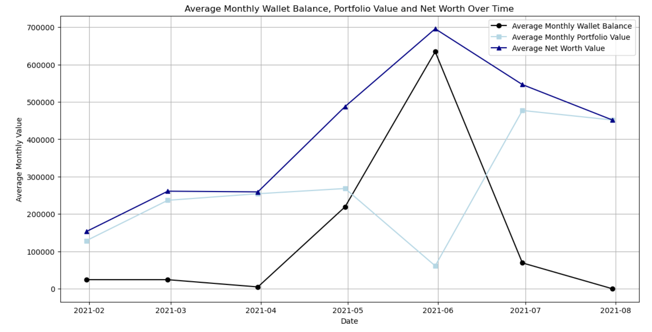
1
Portfolio Optimization
And if that was too much info, here’s a visualization!
There is a significant increase in average net worth and portfolio value around early 2021, with a particularly sharp rise and subsequent fall around mid-2021. Overall, the net worth increases by almost 400% in the span of 6 months

Slide 23
Recommendation

Slide 24



Recommendation | App Based Tracker
Use the app to keep your money close and worries away!
Benefits to Traders
Stop-Loss
Take-Profit
Goal Setting & Tracking
Personalized Recommendations
Higher Average Returns
Real-Time Feedback
Enhanced Trading Experience

Slide 25
Learnings & Future Scope

Slide 26





Future Steps | Model enhancement
Nothing is perfect and so is our model!
Best fit model approach
Hyperparameter tuning & experimentation
Create a best fit approach that fits multiple models for each assets and selects the best according to MAPE
Experiment with different activation functions (ReLU, Leaky ReLU, ELU), search for the optimal learning rate, batch size, and use early stopping to halt when the model’s training performance
Validation Strategies
Leverage External Data
Employ Cross-Validation for time series data to ensure the model is tested on various unseen segments of the data
Test the model against adversarial examples to assess its resilience
Social Media Sentiment Analysis: Integrate sentiment analysis from social media platforms to gauge public sentiment towards specific assets, which can provide leading indicators for market movements

Slide 27




Future Steps | Portfolio optimization
Nothing is perfect and so is our methodology!
Dynamic Asset Allocation
Algorithmic Trading Strategy Development
Employ advanced portfolio optimization techniques, like dynamic rebalancing based on predictive model outputs or adapting to market conditions, to maximize returns or minimize risk
Develop and test various trading strategies (momentum, mean reversion, machine learning-based predictions) to diversify approaches and potentially enhance returns
Continuous Improvement & Adaption
Reinforcement Learning
Establish a process for continuous monitoring and updating of the trading model and strategy, incorporating new data, market insights, and feedback from trading performance to adapt to changing conditions
Apply reinforcement learning algorithms to dynamically adjust portfolio allocations based on learned strategies that maximize rewards (e.g., returns) while penalizing excessive risk

Slide 28

1
Disclaimer!
You are on your own!
*Investing in cryptocurrencies is subject to market risk, and subject to market fluctuations. Before deciding to invest in cryptocurrencies, you should carefully consider your investment objectives, level of experience, and risk appetite. The possibility exists that you could sustain a loss of some or all your initial investment and therefore you should not invest money that you cannot afford to lose. You should be aware of all the risks associated with cryptocurrency trading and seek advice from an independent financial advisor if you have any doubts

Slide 29

Thank you!

